Slide 1
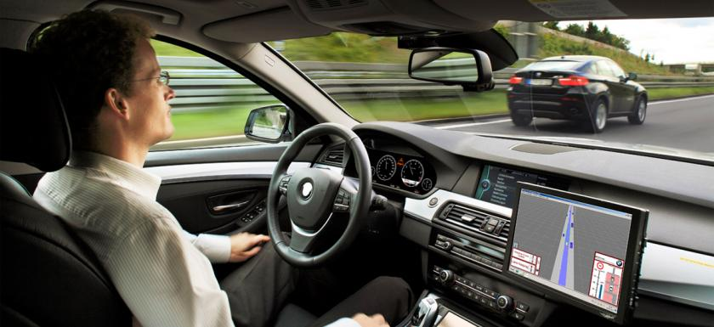
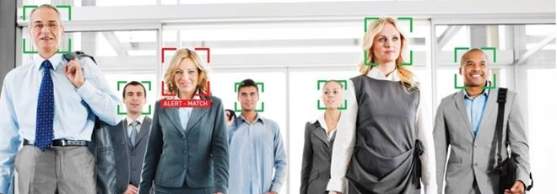
Deep Neural Networks
A course on “Data Science with Python”
Malleswar Yenugu, PhD

Slide 2


Recap…Branches of AI
Artificial Intelligence
Machine Learning
Supervised Learning
Unsupervised Learning
Reinforcement Learning
Neural Networks and Deep Neural Networks

Slide 3
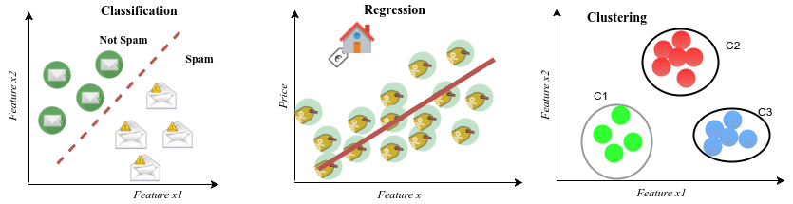
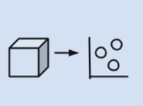
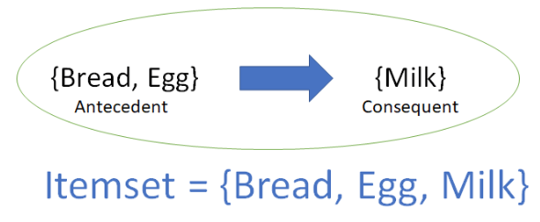
Recap…Supervised and Unsupervised Learning
Supervised Learning
(Develop Predictive models based on both input and output data)
Unsupervised Learning
(Group and Interpret data only based on input data)
Dimensionality Reduction
Association

Slide 4
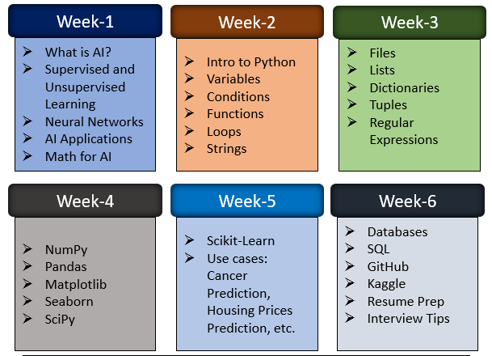
Course Outline

Slide 5
What will we cover Today?
Why Neural Networks?
Types of Deep Neural Networks
Reinforcement Learning

Slide 6
What will we cover Today?
Why Neural Networks?
Types of Deep Neural Networks
Reinforcement Learning

Slide 7
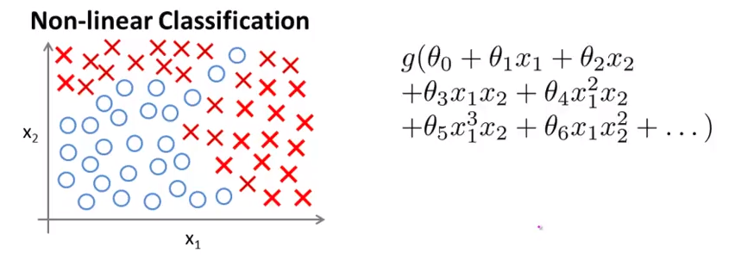
The Problem - Why Neural Networks?

Slide 8
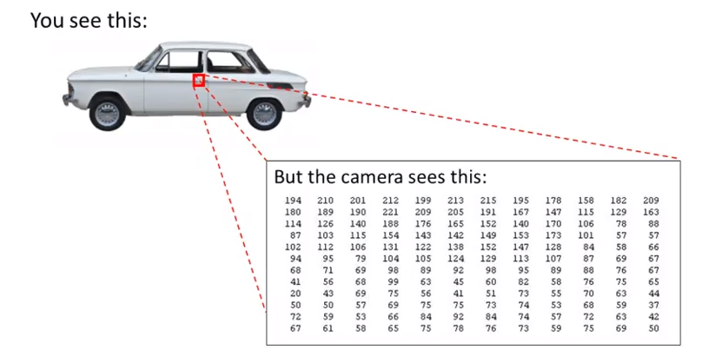
The Problem - Why Neural Networks?
Pixel values
[
]

Slide 9
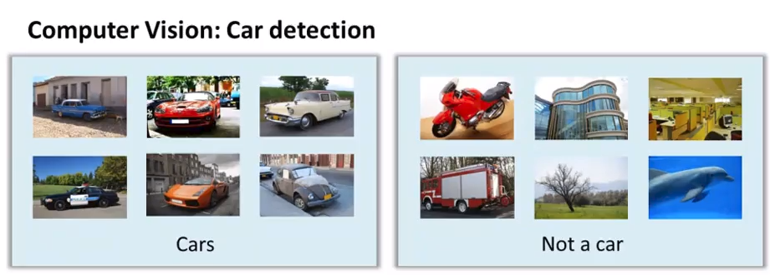
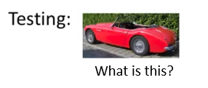
The Problem - Why Neural Networks?

Slide 10
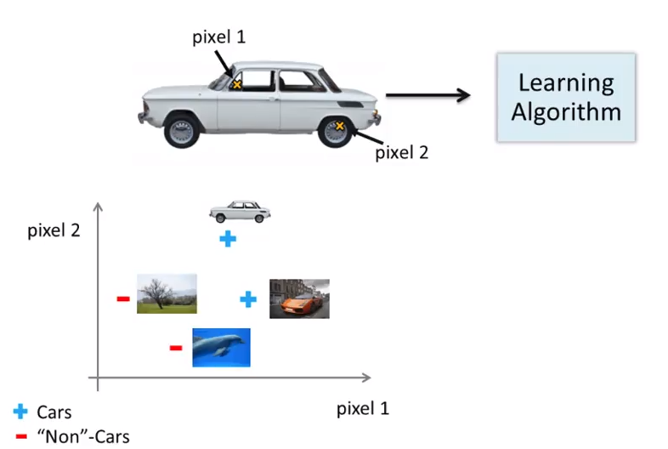
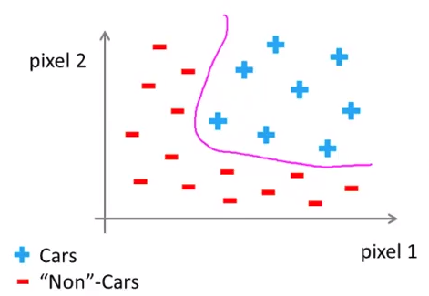
The Problem - Why Neural Networks?
50x50=2500 pixels for black and white images
7500 pixels for colored images (RGB)

Slide 11
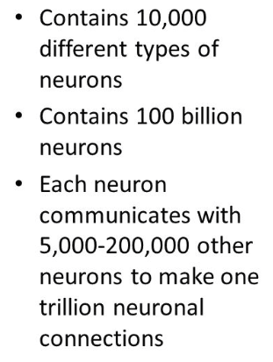
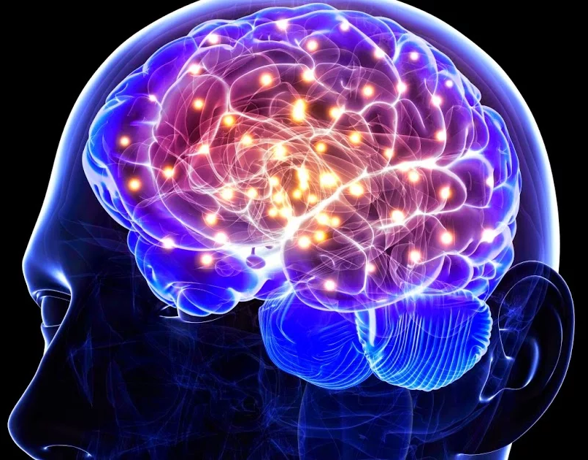
Neurons of Human Brain

Slide 12
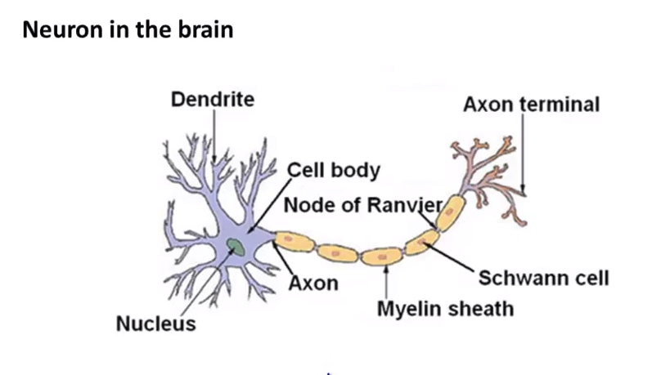
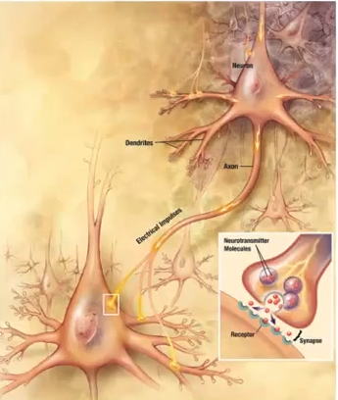
The idea – Natural Neuron
How Neurons communicate?
OUTPUT
INPUT

Slide 13
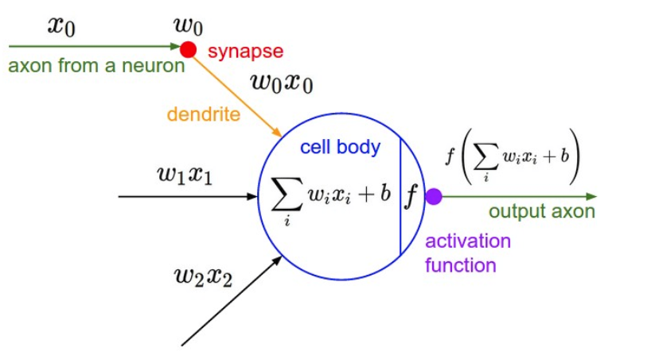
The idea – Artificial Neuron
OUTPUTS
INPUTS

Slide 14
What will we cover Today?
Why Neural Networks?
Types of Deep Neural Networks
Reinforcement Learning

Slide 15
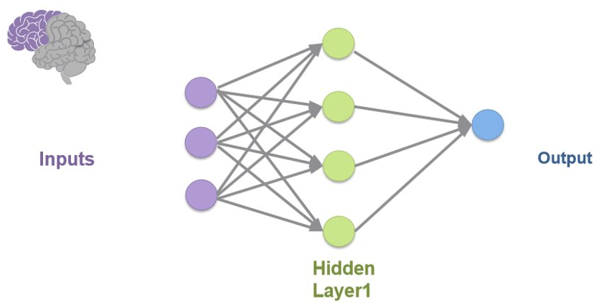
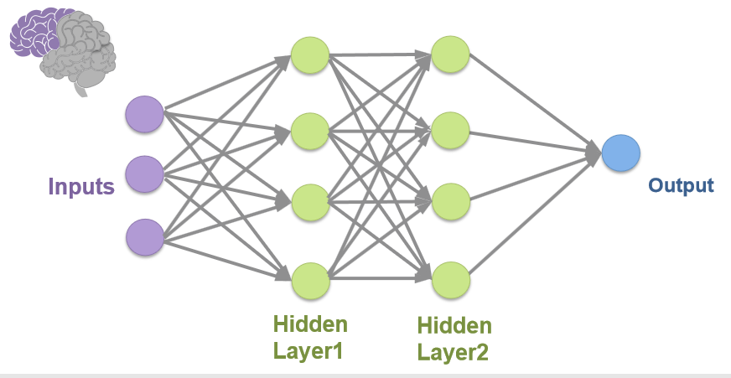
Neural Networks
Simple Neural Network
Multilayered (Deep) Neural Network

Slide 16
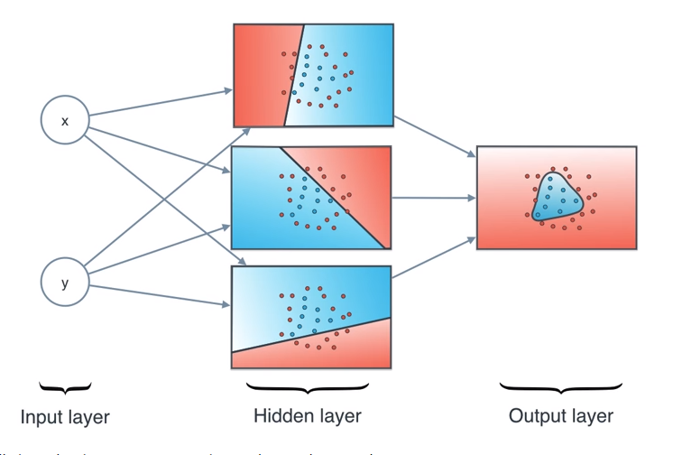
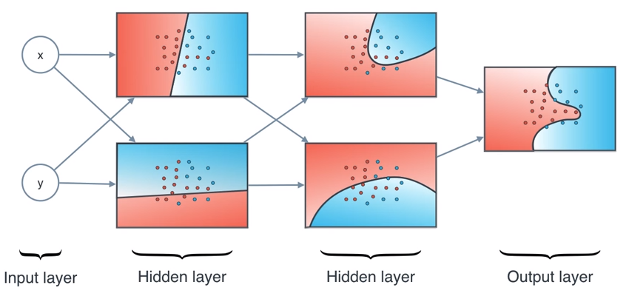
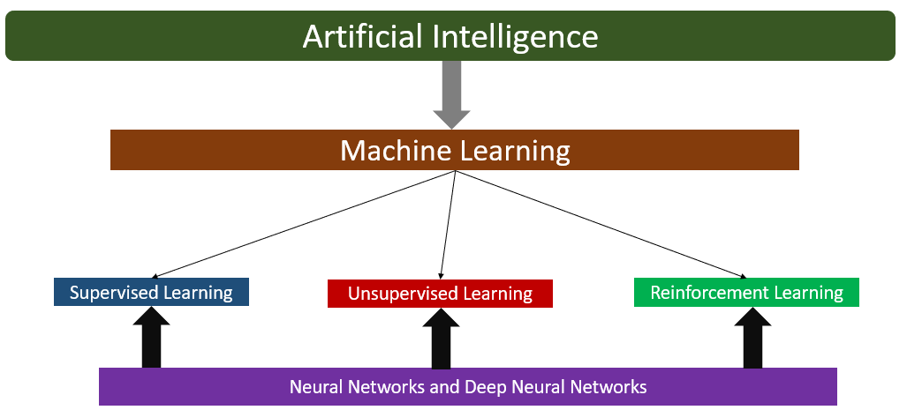
Neural Networks: Example – Structured Data
Simple Neural Network
Deep Neural Network

Slide 17
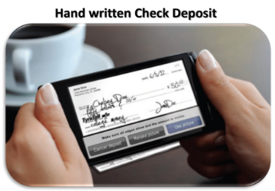
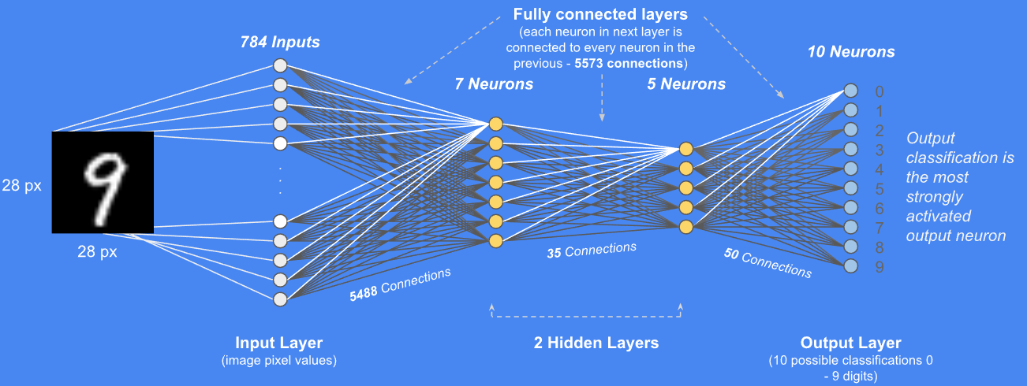
Deep Neural Networks: Example

Slide 18
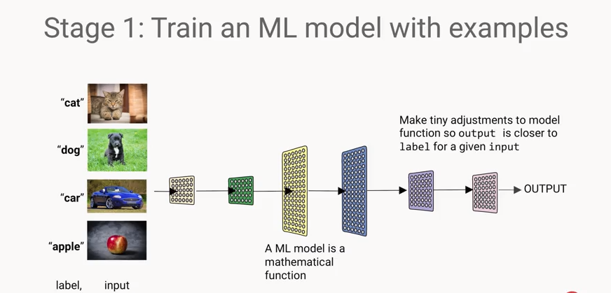
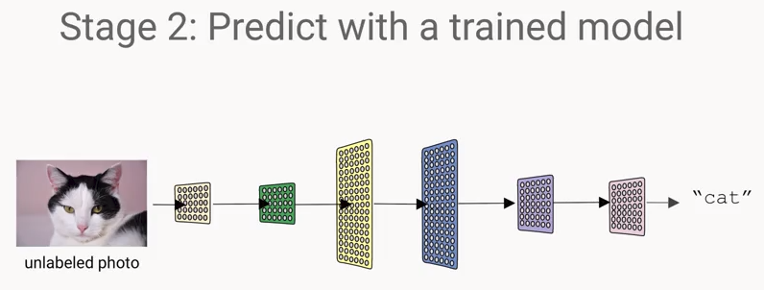
Deep Neural Networks: Example

Slide 19
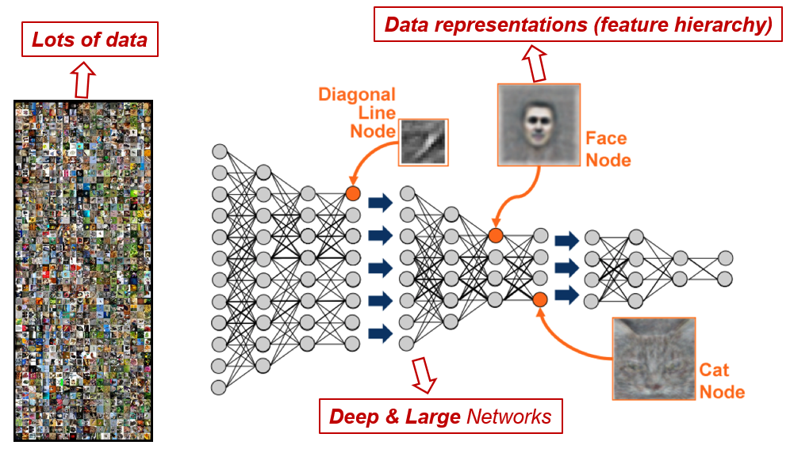
Deep Neural Networks: Example

Slide 20
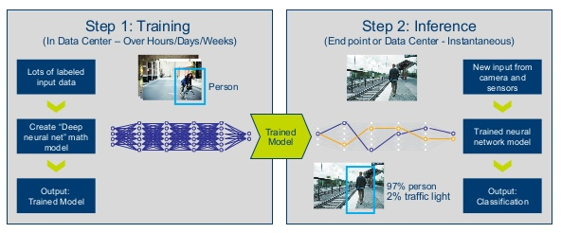
Deep Neural Networks: Example
Facebook System
Facebook User

Slide 21
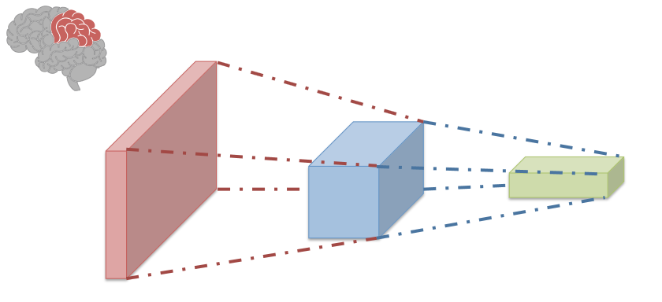
Convolutional Neural Network

Slide 22

Convolutional Neural Network: Example

Slide 23
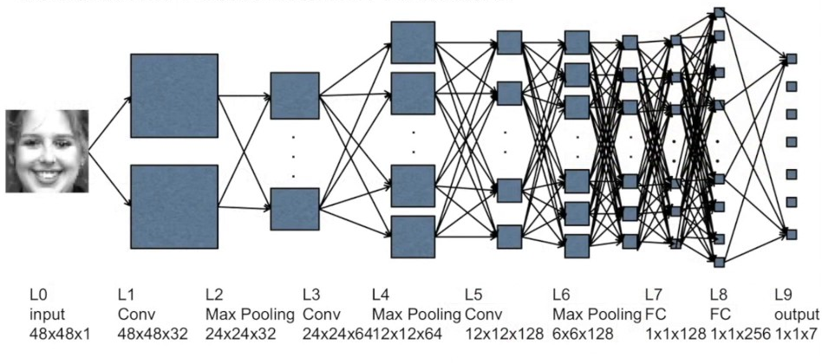
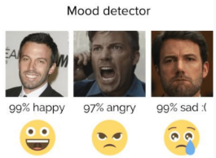
CNN for Facial Recognition and Expressions

Slide 24
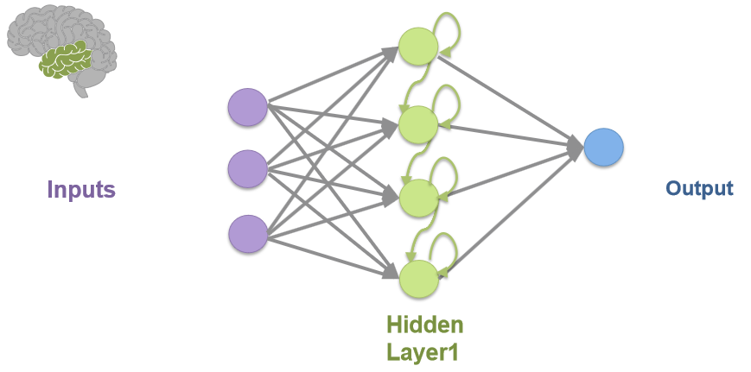
Recurrent Neural Network
Feedback Loop

Slide 25
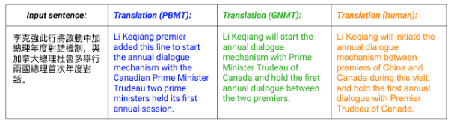
RNN for Language Translation

Slide 26
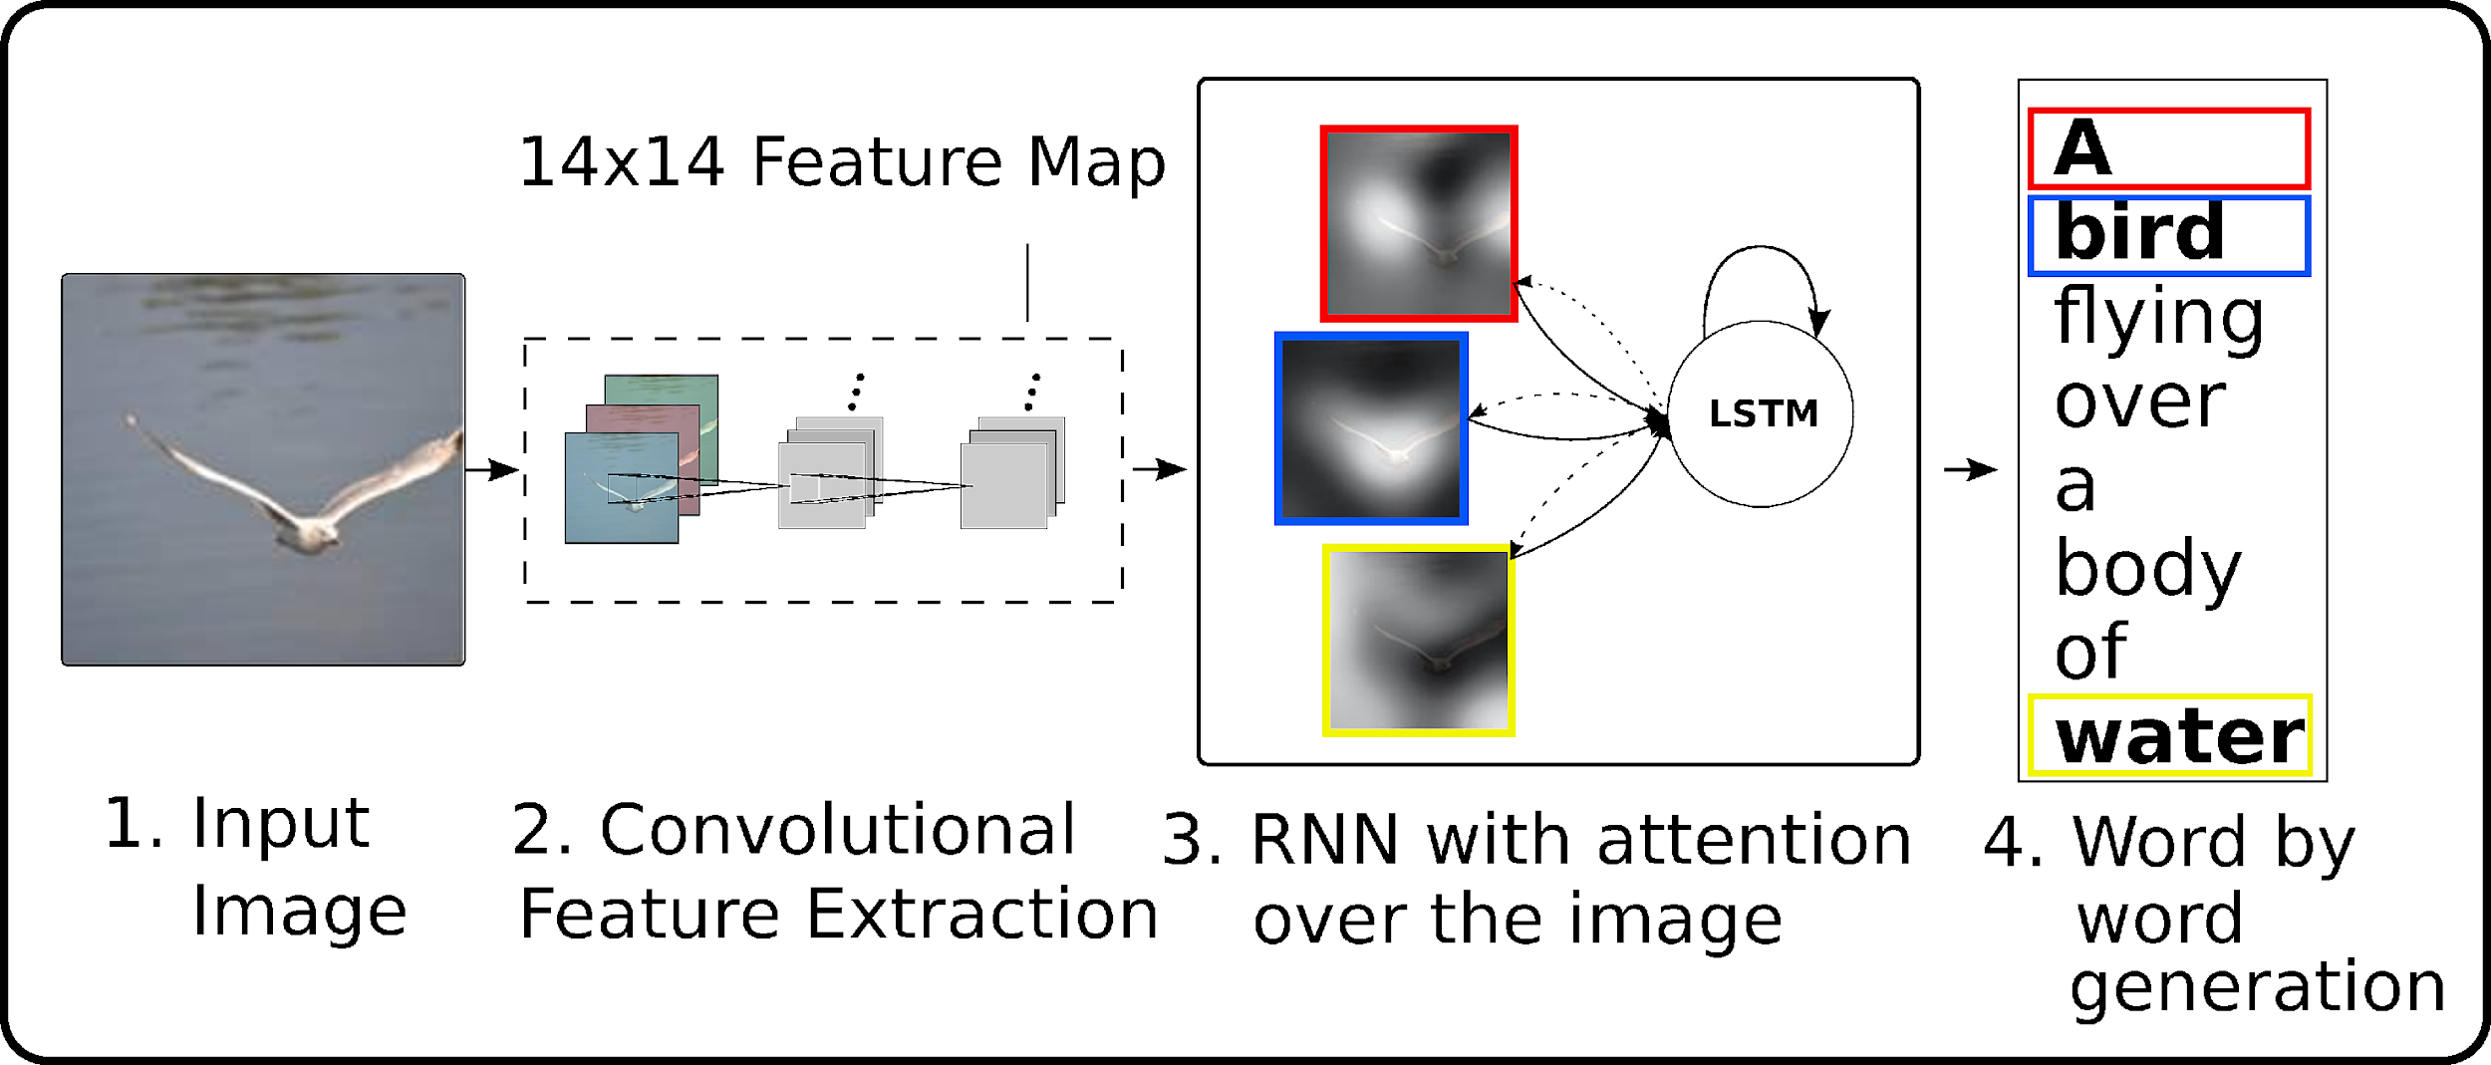
Recurrent Neural Network - Example

Slide 27
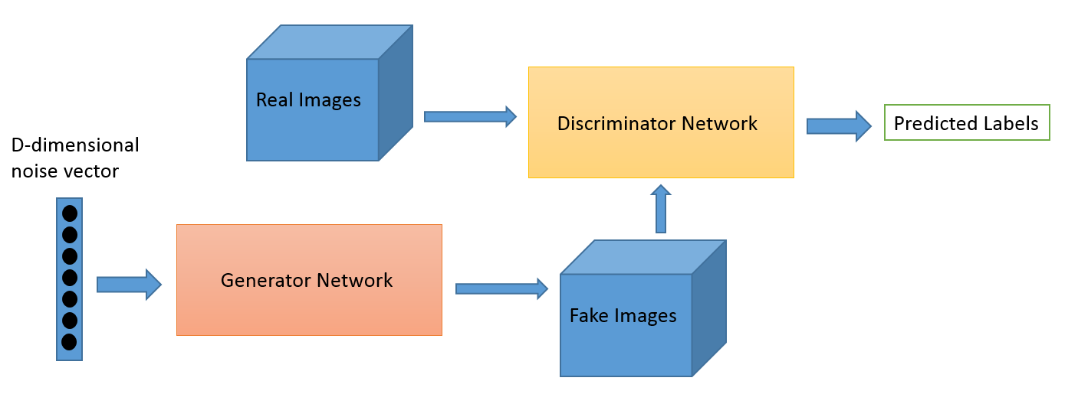
Generative Adversarial Networks (GANs)
GANs can learn to mimic any distribution of data.

Slide 28
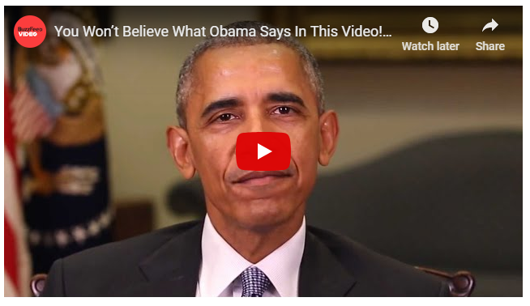
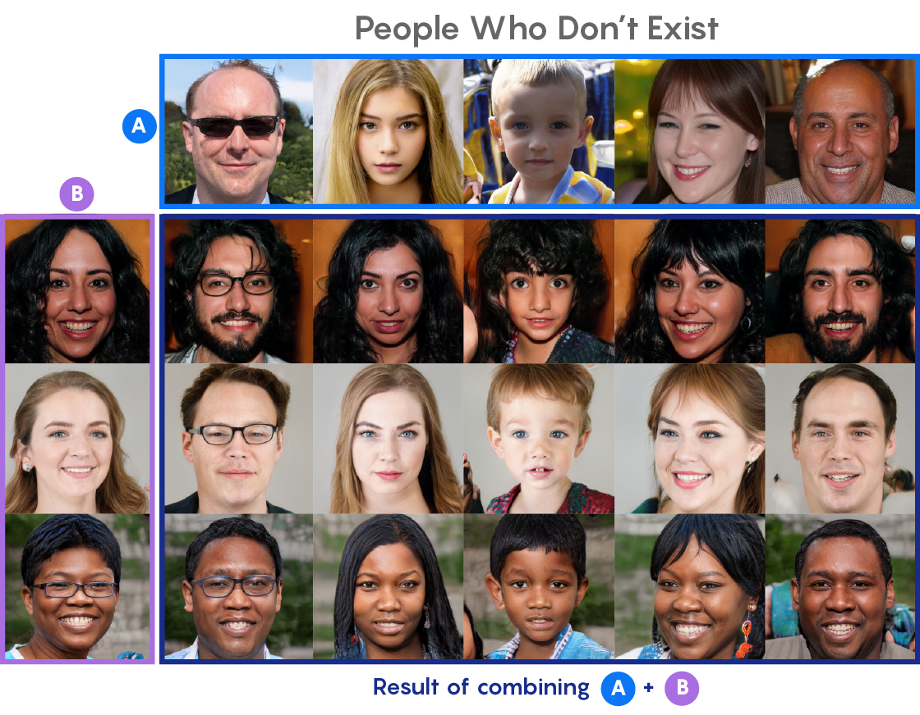
Generative Adversarial Networks (GANs)

Slide 29
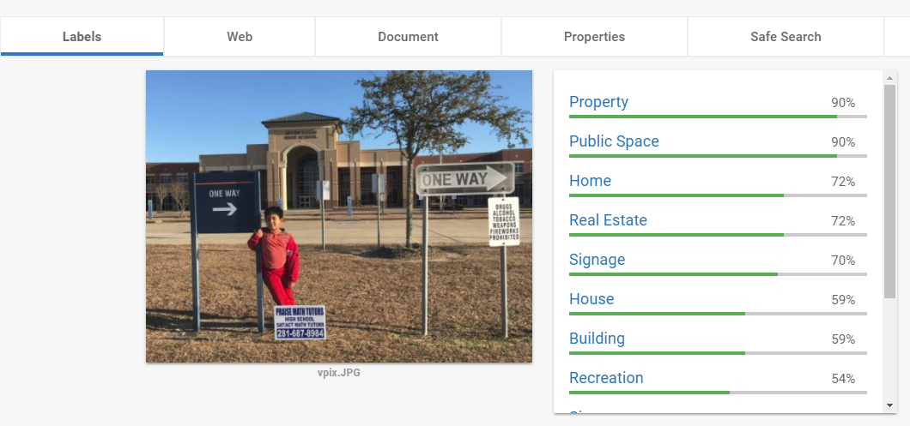
Neural Networks: Example – Computer Vision
www.cloud.google.com/vision/

Slide 30
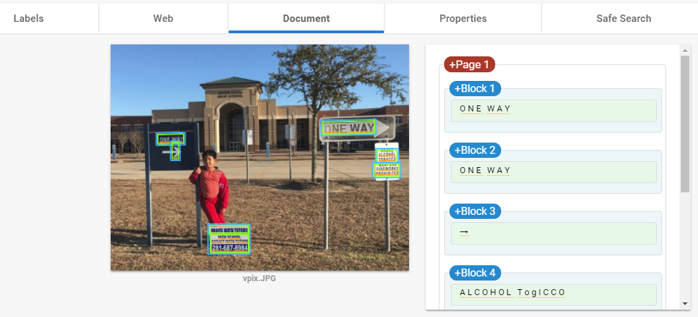
Neural Networks: Example – Computer Vision
www.cloud.google.com/vision/

Slide 31
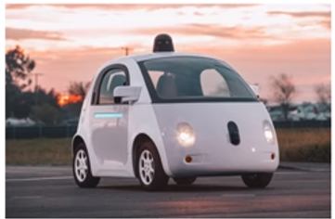
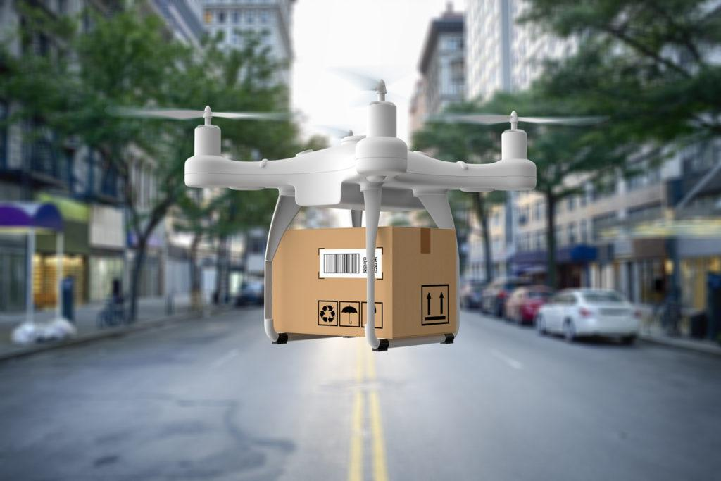
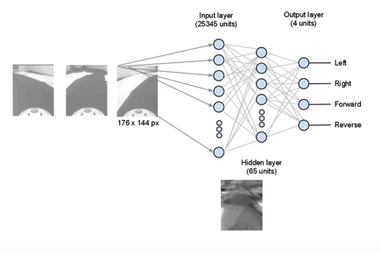
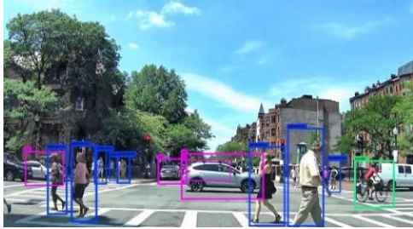
Self Driving Cars – Drones: All types of Deep Learning (NN)

Slide 32
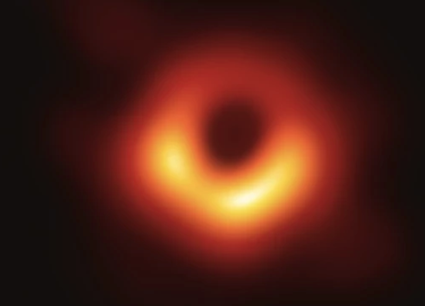
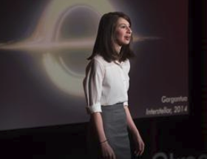
Deep Neural Networks to capture the first ‘Black Hole’
First ever Image of a Black Hole
Katie Bouman – MIT & CIT

Slide 33
What will we cover Today?
Why Neural Networks?
Types of Deep Neural Networks
Reinforcement Learning

Slide 34
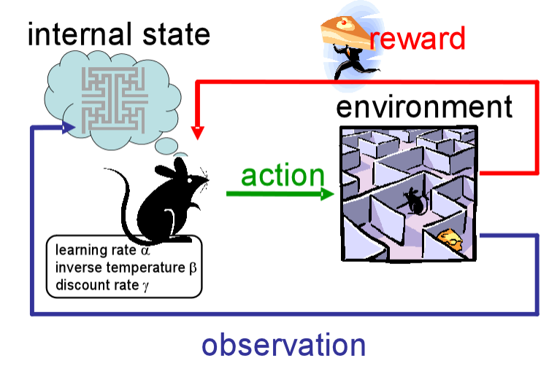
Reinforcement Learning
Learns to react to an environment and rewarded accordingly

Slide 35
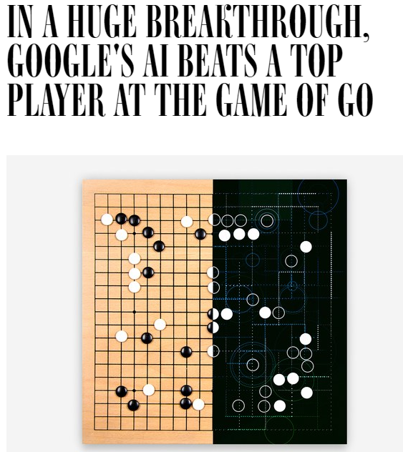

Reinforcement Learning: Example

Slide 36
Summary…
CNN
RNN
GAN

Slide 37
Tomorrow?

